Slide 1
09. Flow of Control: Loops
[ECE20016/ITP20003] Java Programming
Notes:
‹#›

Slide 2
Agenda
Java Loop Statements
Programming with Loops

Slide 3
Java Loop Statements
A portion of a program that repeats a statement or a group of statements is called a loop.
The statement or group of statements to be repeated is called the body of the loop.

Slide 4
Java Loop Statements
The while statement
The do-while statement
The for Statement

Slide 5
The while Statement
Also called a while loop
A while statement repeats while a controlling boolean expression remains true
The loop body typically contains an action that ultimately causes the controlling boolean expression to become false.

Slide 6
WhileDemo
import java.util.Scanner;
public class WhileDemo
{
public static void main (String [] args)
{
int count, number;
System.out.println ("Enter a number");
Scanner keyboard = new Scanner (System.in);
number = keyboard.nextInt ();
count = 1; // loop variable
while (count <= number) // control expression
{
System.out.print (count + ", ");
count++; // sometimes, makes ‘count <= number’ false
}
System.out.println ();
System.out.println ("Buckle my shoe.");
}
}

Slide 7
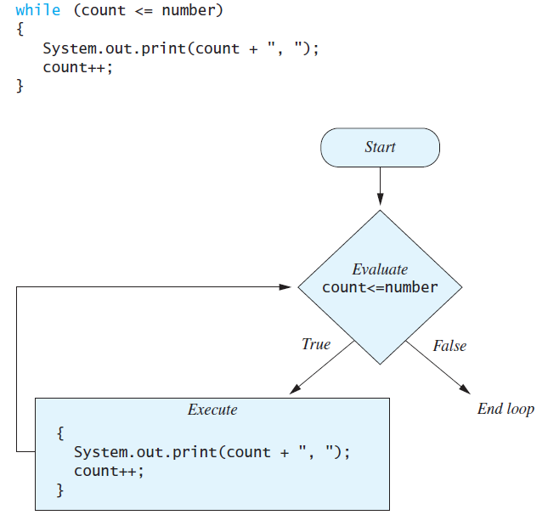
The while Statement

Slide 8
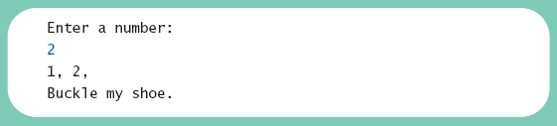
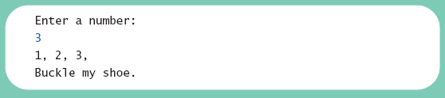
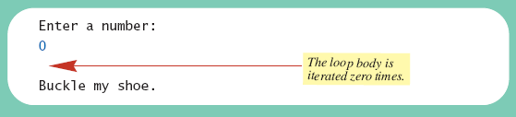
WrileDemo
Result

Slide 9
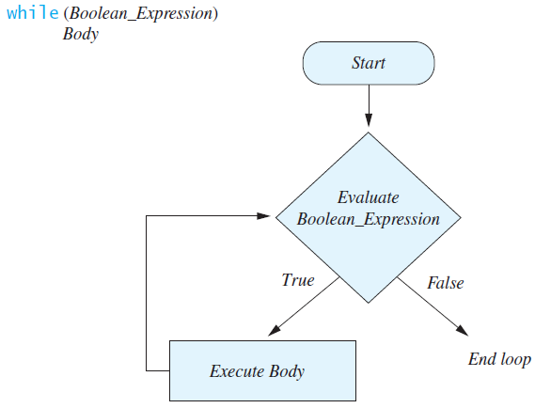
The while Statement
Syntax
while (Boolean_Expression)
Body_Statement
Or
while (Boolean_Expression)
{
First_Statement
Second_Statement
…
}

Slide 10
The do-while Statement
Also called a do-while loop
Similar to a while statement, except that the loop body is executed at least once
Syntax
do
Body_Statement
while (Boolean_Expression);
Don’t forget the semicolon!

Slide 11
DoWhileDemo
import java.util.Scanner;
public class DoWhileDemo
{
public static void main (String [] args)
{
int count, number;
System.out.println ("Enter a number");
Scanner keyboard = new Scanner (System.in);
number = keyboard.nextInt ();
count = 1;
do
{
System.out.print (count + ", ");
count++;
}
while (count <= number);
System.out.println ();
System.out.println ("Buckle my shoe.");
}
}

Slide 12
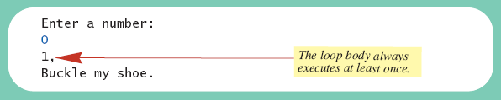
DoWhileDemo
Result

Slide 13
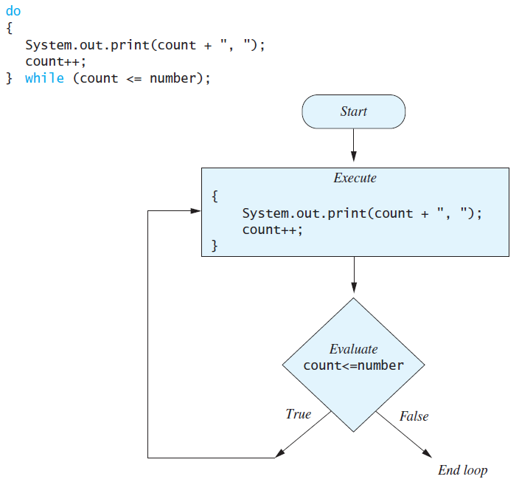
The do-while Statement

Slide 14
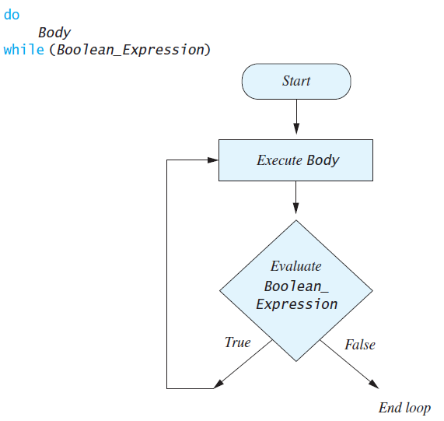
The do-while Statement
First, the loop body is executed.
Then the boolean expression is checked.
As long as it is true, the loop is executed again.
If it is false, the loop is exited.
Equivalent while statement
Statement(s)_S1
while (Boolean_Condition)
Statement(s)_S1

Slide 15
Programming Example: Bug Infestation
Given
Volume a roach: 0.002 cubic feet
Starting roach population
Rate of increase: 95%/week
Volume of a house
Find
Number of weeks to exceed the capacity of the house
Number and volume of roaches

Slide 16
Programming Example: Bug Infestation
Algorithm for roach population program (rough draft)
1. Get volume of house.
2. Get initial number of roaches in house.
3. Compute number of weeks until the house is full of roaches.
4. Display results.

Slide 17
Programming Example: Bug Infestation
Variables needed
GROWTH_RATE —weekly growth rate of the roach population (a constant 0.95)
ONE_BUG_VOLUME —volume of an average roach (a constant 0.002)
houseVolume — volume of the house
startPopulation —initial number of roaches
countWeeks —week counter
population —current number of roaches
totalBugVolume —total volume of all the roaches
newBugs —number of roaches hatched this week
newBugVolume —volume of new roaches

Slide 18
Detailed Algorithm
Algorithm for roach population program
1. Read houseVolume
2. Read startPopulation
3. population = startPopulation
4. totalBugVolume = population * ONE_BUG_VOLUME
5. countWeeks = 0
6. while (totalBugVolume < houseVolume)
{
newBugs = population * GROWTH_RATE
newBugVolume = newBugs * ONE_BUG_VOLUME
population = population + newBugs
totalBugVolume = totalBugVolume + newBugVolume
countWeeks = countWeeks + 1
}
7. Display startPopulation, houseVolume, countWeeks, population, and
totalBugVolume

Slide 19
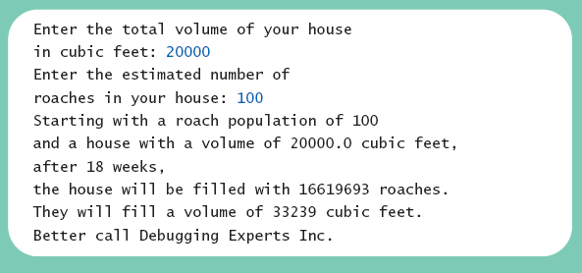
Programming Example: Bug Infestation
Result

Slide 20
Infinite Loops
A loop which repeats without ever ending is called an infinite loop.
If the controlling boolean expression never becomes false, a while loop or a do-while loop will repeat without ending.
Ex) A negative growth rate in the preceding problem causes totalBugVolume always to be less than houseVolume

Slide 21
Nested Loops
The body of a loop can contain any kind of statements, including another loop. // an outer loop while (Boolean_Expression){ [statements…] // a loop in an outer loop // a nested loop or an inner loop while(Boolean_Expression) { [statements…] } }

Slide 22
The for Statement
A for statement executes the body of a loop a fixed number of times.
Syntax
for(Initialization; Condition; Update)
Body_Statement
Body_Statement can be either a simple statement or a compound statement.
Ex) for (count = 1; count < 3; count++)
System.out.println(count);
Corresponding while statement
Initialization
while (Condition)
Body_Statement_Including_Update

Slide 23
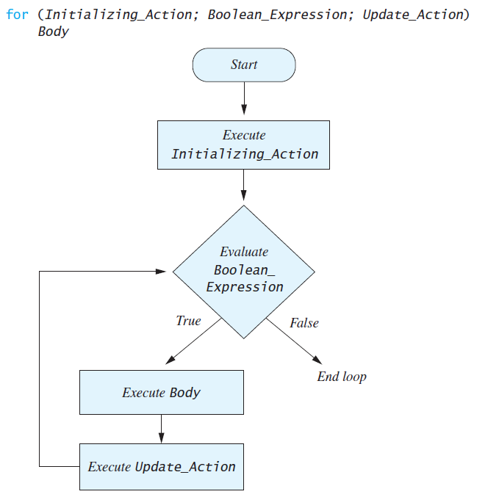
The for Statement

Slide 24
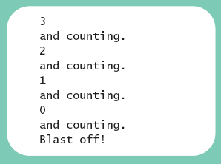
ForDemo
public class ForDemo
{
public static void main (String [] args)
{
int countDown;
for (countDown = 3 ; countDown >= 0 ; countDown--) {
System.out.println (countDown);
System.out.println ("and counting.");
}
System.out.println ("Blast off!");
}
}

Slide 25
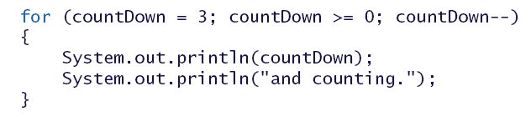
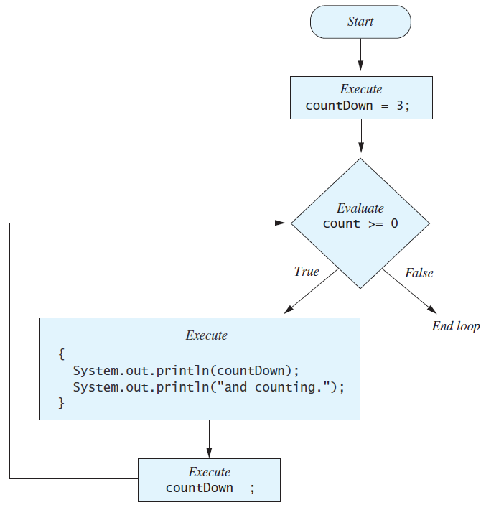
The for Statement

Slide 26
The for Statement
Possible to declare variables within a for statement
int sum = 0;
for (int n = 1; n <= 10; n++)
sum = sum + n * n;
Note that variable n is local to the loop

Slide 27
The for Statement
A comma separates multiple initializations
for (n = 1, product = 1; n <= 10; n++)
product = product * n;
Only one boolean expression is allowed, but it can consist of &&s, ||s, and !s.
Multiple update actions are allowed, too.
for (n = 1, product = 1; n <= 10; product = product * n, n++);

Slide 28
The for-each Statement
Possible to step through values of an enumeration type
Example enum Suit {CLUBS, DIAMONDS, HEARTS, SPADES}
for (Suit nextSuit : Suit.values())
System.out.print(nextSuit + " ");
System.out.println();

Slide 29
Agenda
Java Loop Statements
Programming with Loops

Slide 30
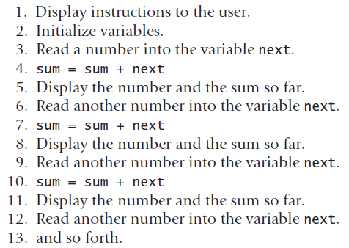
The Loop Body
To design the loop body, write out the actions the code must accomplish.
Ex) Read numbers from the user and compute the sum of them

Slide 31
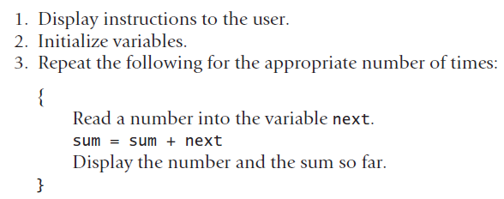
The Loop Body
Then, look for a repeated pattern.
The repeated pattern will form the body of the loop.

Slide 32
Initializing Statements
Some variables need to have a value before the loop begins.
Other variables get values only while the loop is iterating.

Slide 33
Controlling Number of Loop Iterations
If the number of iterations is known before the loop starts, the loop is called a count-controlled loop.
Use a for loop.
Asking the user before each iteration if it is time to end the loop is called the ask-before-iterating technique.
Appropriate for a small number of iterations
Use a while loop or a do-while loop.

Slide 34
Controlling Number of Loop Iterations
For large input lists, a sentinel value can be used to signal the end of the list.
The sentinel value must be different from all the other possible inputs.
A negative number following a long list of nonnegative exam scores could be suitable.
90
0
10
-1

Slide 35
Controlling Number of Loop Iterations
Ex) Reading a list of scores followed by a sentinel value
int next = keyboard.nextInt();
while (next >= 0)
{
Process_The_Score
next = keyboard.nextInt();
}

Slide 36
BooleanDemo
import java.util.Scanner;
public class BooleanDemo
{
public static void main (String [] args)
{
System.out.println ("Enter nonnegative numbers.");
System.out.println ("Place a negative number at the end");
System.out.println ("to serve as an end marker.");
int sum = 0;
boolean areMore = true;
Scanner keyboard = new Scanner (System.in);
while (areMore)
{
int next = keyboard.nextInt ();
if (next < 0)
areMore = false;
else
sum = sum + next;
}
System.out.println ("The sum of the numbers is " + sum);
}
}

Slide 37
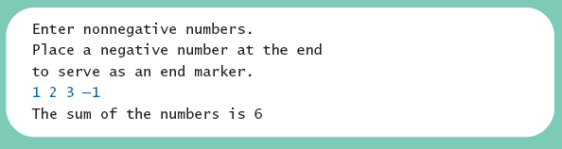
BooleanDemo
Result

Slide 38
The break Statement in Loops
A break statement can be used to end a loop immediately.
The break statement ends only the innermost loop or switch statement that contains the break statement.
Use break statements sparingly (if ever).
break statements make loops more difficult to understand.

Slide 39
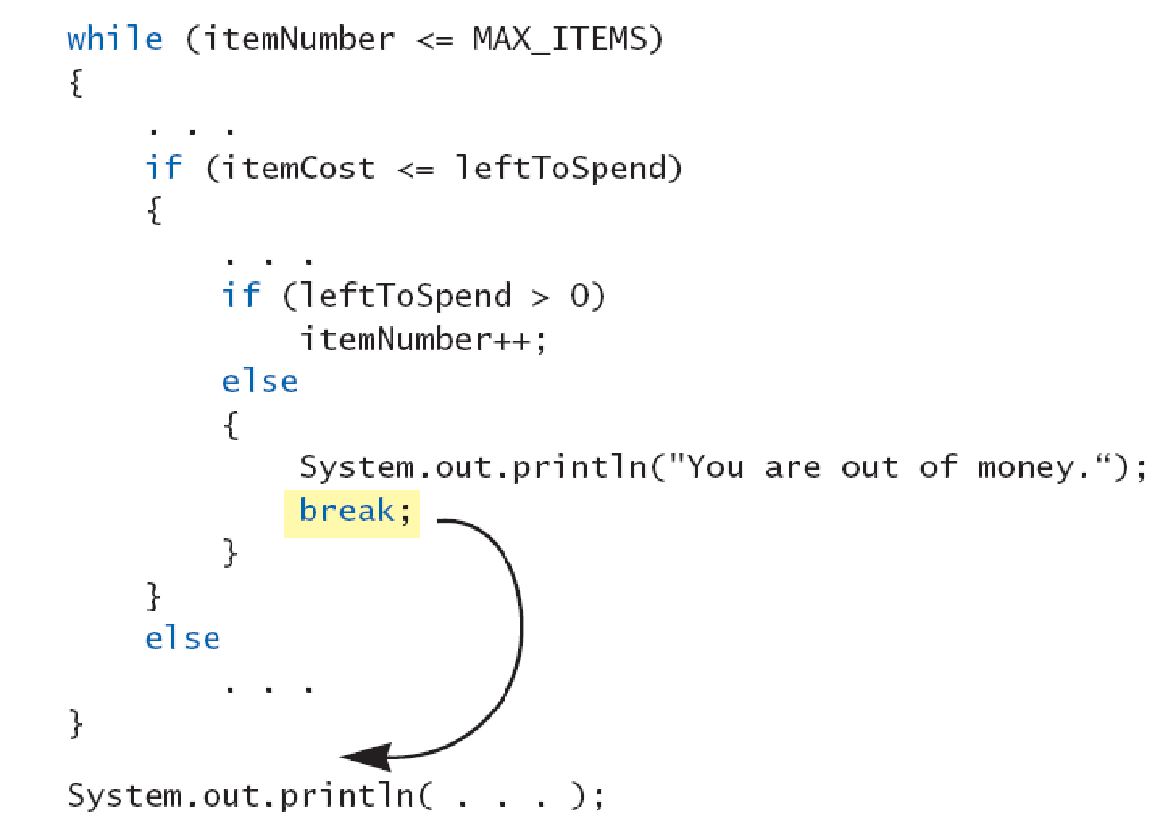
The break Statement in Loops
Note program fragment, ending a loop with a break statement,

Slide 40
The continue Statement in Loops
A continue statement
Ends current loop iteration
Begins the next one
Text recommends avoiding use
Introduce unneeded complications

Slide 41
Tracing Variables
Tracing variables means watching the variables change while the program is running.
Simply insert temporary output statements in your program to print of the values of variables of interest
Or, learn to use the debugging facility (debugger) that may be provided by your system.

Slide 42
Loop Bugs
Common loop bugs
Unintended infinite loops
Off-by-one errors
Testing equality of floating-point numbers
Subtle infinite loops
The loop may terminate for some input values, but not for others.
Ex) You can’t get out of debt when the monthly penalty exceeds the monthly payment.

